Slide 1
#Mai_Bhi_Chowkidaar.
Presented By: Yash Sharma

Slide 2
Problem Statement:
"Mai Bhi Chowkidaar" is a platform which will be used for the rental or buying/saling of a flat, the platform will provide the user both the facilities to either upload an advertisement or view the uploaded ones, as the name suggests it will focus to join more and more of the watchmen of all the societies as they know better about the flats to be rented or for saling. At this early stage the app will only focus on the Pune city of Maharashtra.

Slide 3
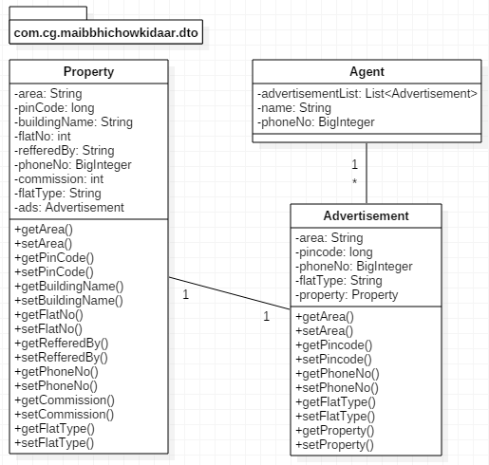
POJO Classes with Relationship

Slide 4
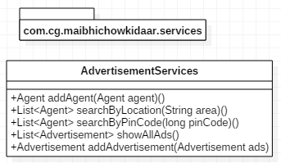
Service Classes

Slide 5
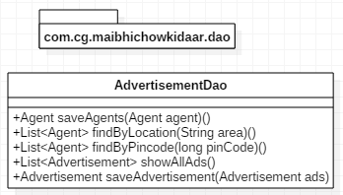
DAO Classes

Slide 6
Thank You.
Any Question?

